Slide 1

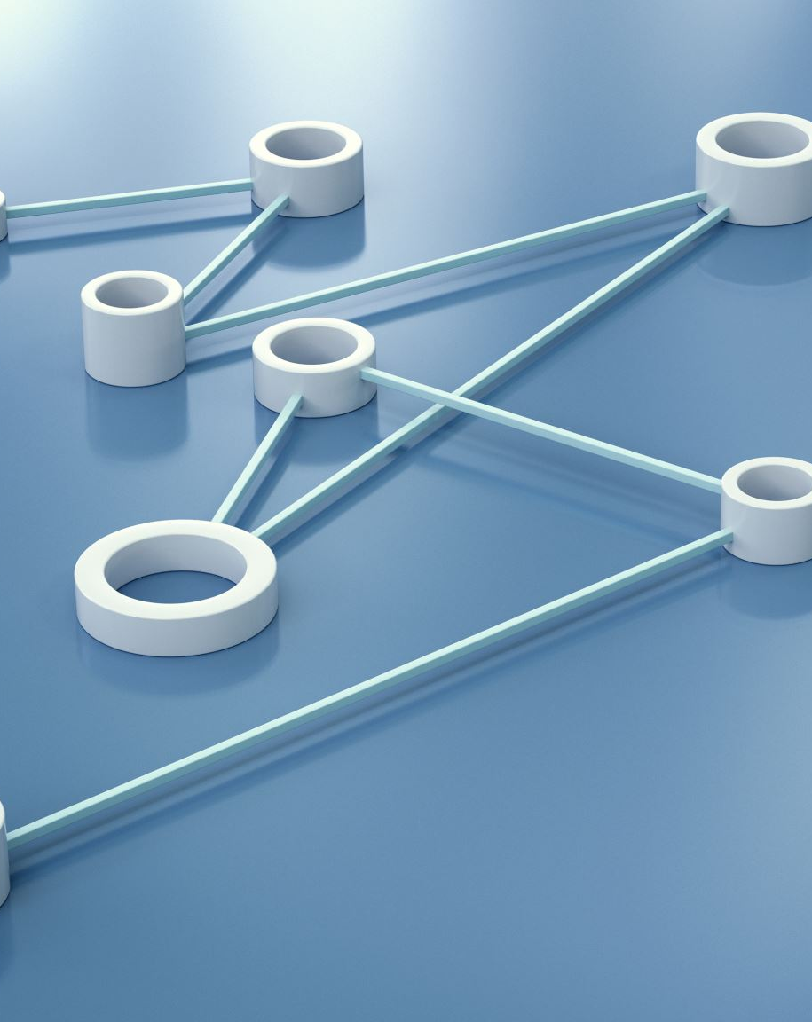
NETWORKING FUNDAMENTALS
INTRODUCTION TO NETWORKS
Presented By: Aminata Jalloh

Slide 2
INTRODUCTION
A network is a group of computers and other devices, such as personal Digital Assistant (PDA) or a printer, connected with a medium, such as a cable. A network can be created to enable the devices communicate or share resources, such as file or a printer.

Slide 3
A network provides various features and they are as follow:
Data Sharing: You can access or share data stored on a computers over a network spread across geographical location.
Resource Sharing: You can share a hardware peripheral devices, such as printers and scanners, over the network rather than investing in individuals' resources for each computer

Slide 4
DATA & INFORMATION
Data: Refers to the raw facts that are collected while information refers to processed data that enables us to take decisions.
Example; When result of a particular test is declared it contains data of all students, when you find the marks, you have scored you have the information that lets you
know whether you have passed or failed.
The word data refers to any information which is presented in a form that is agreed and accepted upon by is creators and users.

Slide 5
DATA COMMUNICATION
Data Communication: is a process of exchanging data or information In case of computer networks this exchange is done between two devices over a transmission medium.

Slide 6
Characteristics of Data Communication
The effectiveness of any data communications system depends upon the following four fundamental characteristics:
Delivery: The data should be delivered to the correct destination and correct user.
Accuracy: The communication system should deliver the data
accurately, without introducing any errors. The data may get corrupted during transmission affecting the accuracy of the delivered data.
Timeliness: Audio and Video data has to be delivered in a timely manner without any delay; such a data delivery is called real time transmission of
data.
Jitter: It is the variation in the packet arrival time. Uneven Jitter may
affect the timeliness of data being transmitted.

Slide 7
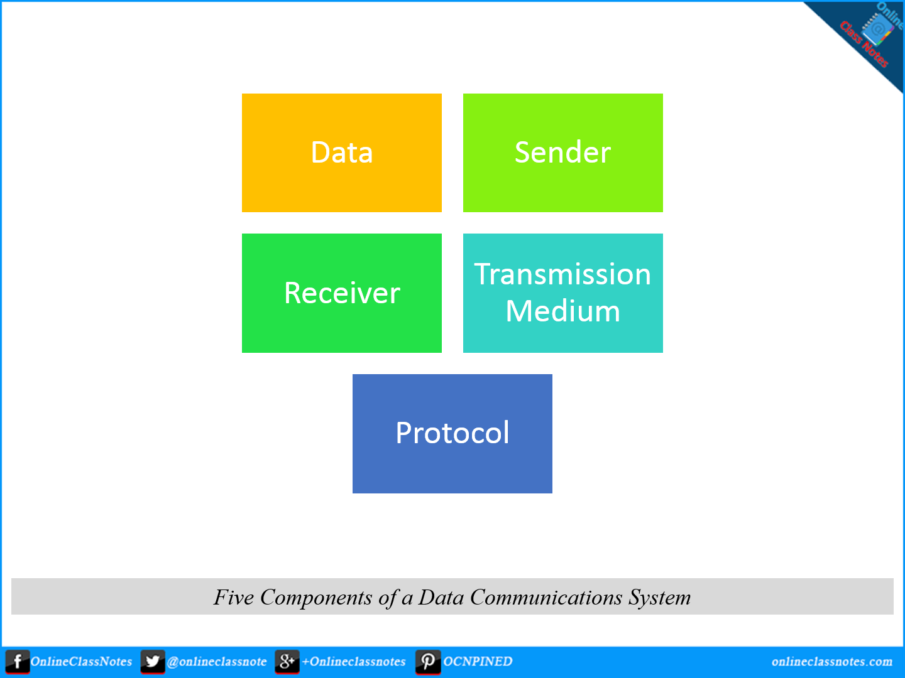
Components of Data Communication
A Data Communication system has five components as shown in the diagram below:

Slide 8
DATA
  Message is the information to be communicated by the sender to the receiver.
SENDER
  The sender is any device that can send the data sender is any device that can send the data
RECEIVER
  The receiver is a device that the sender wants to
  communicate the data.
  It is the path by which the message travels from
  sender to receiver. It is the path by which the message travels from
  sender to receiver. It can be wired or wireless and many subtypes in both.
Transmission Medium
Protocol
  It is an agreed upon set or rules used by the sender and
  receiver to communicate data.

Slide 9
POSSIBILITIES UNLIMITED
THE INTERNET

Slide 10
The internet is a vast interconnection of computers that connect computers across the world; and it is used for accessing information and communication.
INTRODUCTION

Slide 11
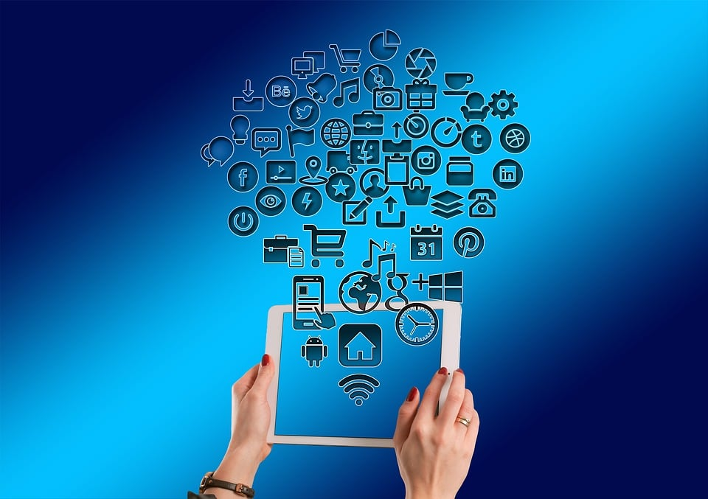
A global network connecting billions of devices.
Enables communication, information sharing, and access to vast resources.
Evolution from ARPANET to the modern internet.
Key technologies: World Wide Web, email, social media.

Slide 12
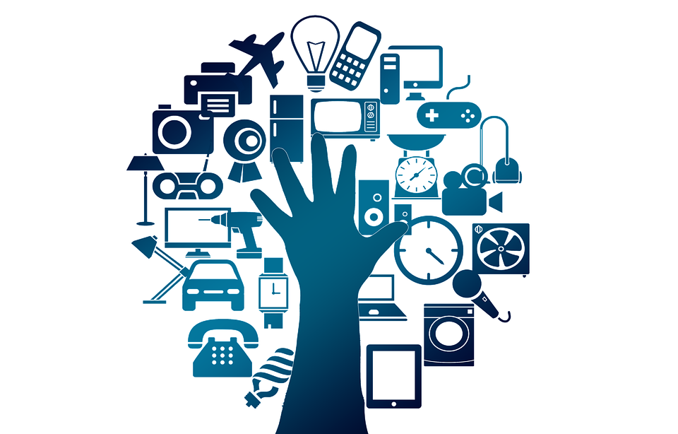
COMMUNICATION & COLLABORATION
  Email: Instant messaging and global reach.
  Social media: Connecting with friends, family, and communities.
  Video conferencing: Remote meetings and collaboration.

Slide 13
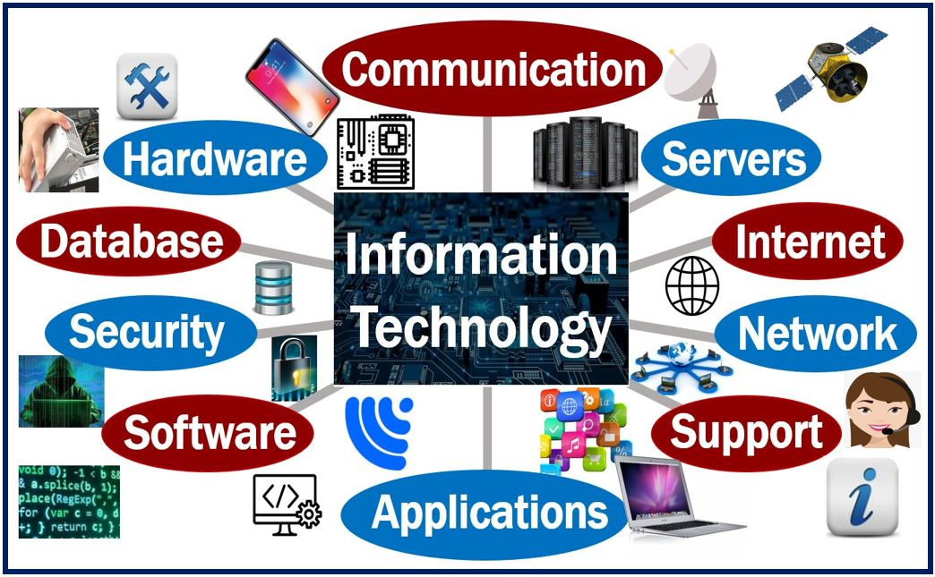
INFORMATION & KNOWLEDGE
  Access to vast online libraries and databases.
  Research, learning, and staying informed.
  Online courses and educational resources.

Slide 14
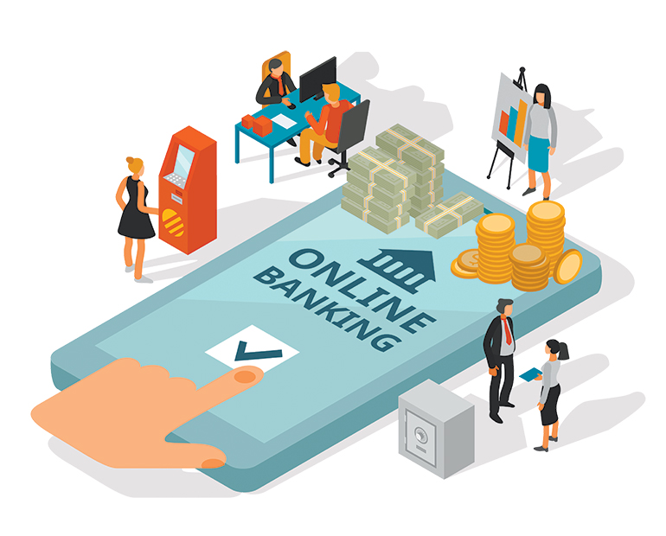
COMMERCE & TRANSACTIONS
  Online shopping and e-commerce.
  Banking and financial transactions.
  Job searching and career development.

Slide 15
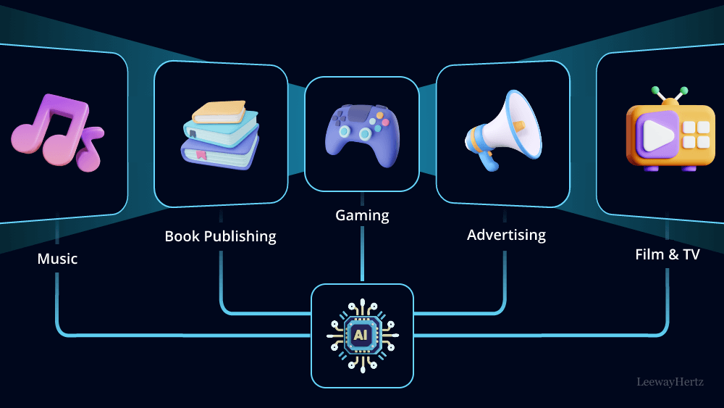
ENTERTAINMENT & MEDIA
  Streaming movies and music.
  Gaming and online entertainment.
  Social interaction through online communities.

Slide 16
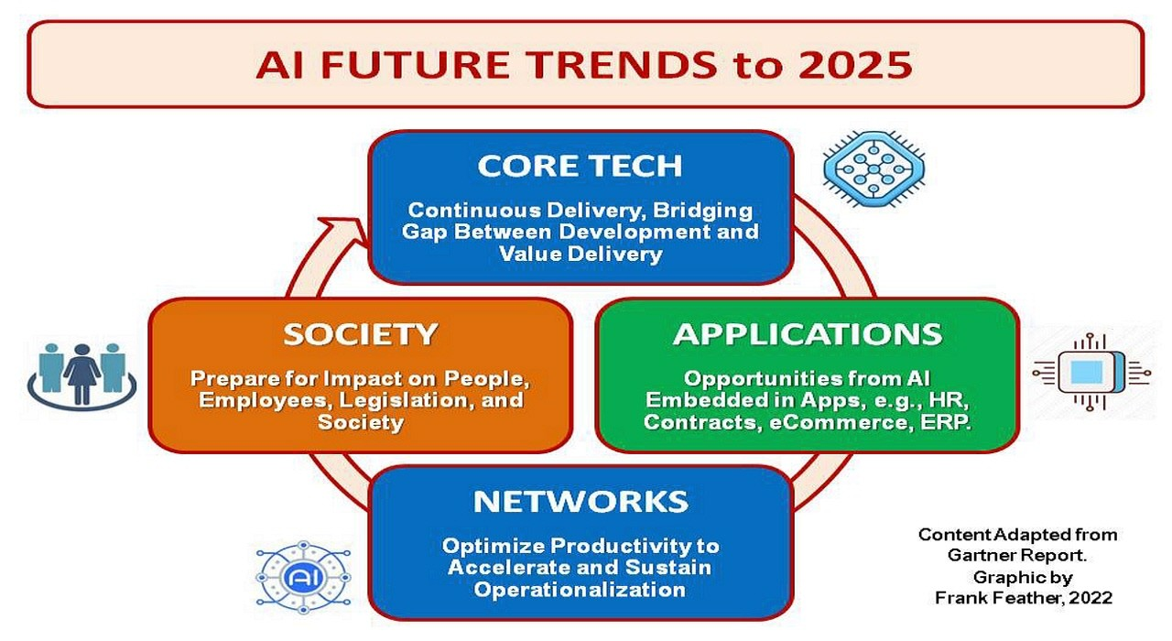
INNOVATION & FUTURE TRENDS
  Artificial Intelligence (AI) and machine learning.
  Internet of Things (IoT).
  Cloud computing and big data.

Slide 17
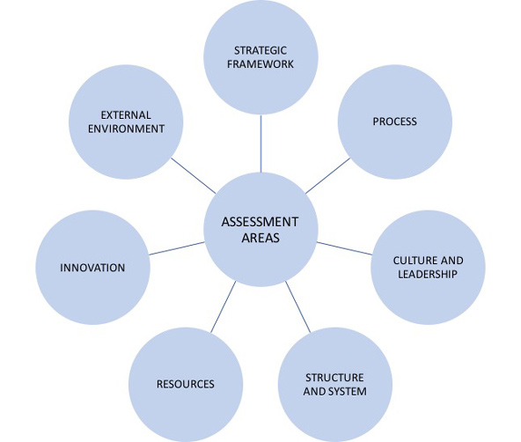
THE INTERNET'S IMPACT
Positive Impacts
  Increased access to information and education.
  Global connectivity and communication.
  Economic opportunities and growth.

Slide 18
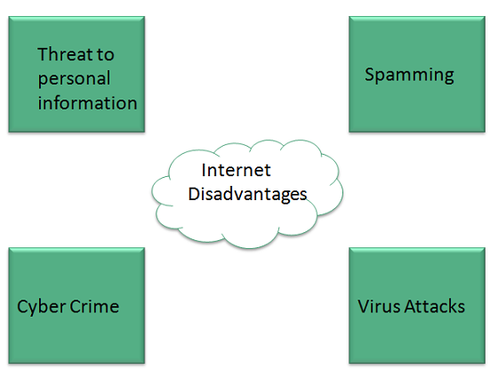
Potential Challenges
  Cybersecurity threats and data privacy.
  The spread of misinformation and fake news.
  Social isolation and addiction.

Slide 19
THE FUTURE OF THE INTERNET
  The internet continues to evolve at a rapid pace.
  Further integration into our daily lives.
  Importance of responsible internet use.

Slide 20
THANKYOU FOR YOUR ATTENTION
OPEN FOR QUESTIONS & DISCUSSION

